Slide 1
P44 - Multimodal VR Simulation with Inverse3 Haptic Device
Group: SOFT3888_TU12_02_P44
Client: FMH Media Lab
Tutor: Islam Alzoubi
Tutorial: Tuesday 12PM
Notes:
https://uni-sydney.zoom.us/j/6082063296?pwd=c0tHcE1wRGZ3MUlvWkVrNjJCM2pMZz09

Slide 2
Agenda
User Stories Developed
System Design and Architecture
Quality of Technical Work
Success/Acceptance Criteria for Results
Project Limitations and Handover
Live Demo

Slide 3
Completed User Stories
As a customer…
I want the VR simulation to be synchronised seamlessly with the haptic device so that my interactions feel smooth and responsive. | FR-01: VR Environment Interaction FR-04: Device Synchronisation
I want the haptic device to give realistic feedback so that I can recognise the physical properties of distinct tissue materials. | FR-02: Real-time haptic feedback FR-03: Tissue material library
I want to feel accurate resistance when injecting the virtual syringe so that I can practice proper blood-draw technique when puncturing skin, vein and/or muscle. | FR-05: Syringe simulation FR-03: Tissue material library
I want to simulate inserting a needle into a human arm so that I can practice a realistic blood-draw on an anatomically accurate 3D model. | FR-05: Syringe simulation FR-06: 3D Models

Slide 4
Completed User Stories
As a customer…
I want the simulation to run smoothly so that I experience responsive VR interactions without lag or jitter. | NFR-01: Performance
I want an appealing 3D environment that accurately represents a typical medical setting so that I feel immersed in the simulation. | NFR-01 + 03: Reliability + Performance
I want the simulation to be bug-free and properly tested so that I can rely on the system for accurate haptic interactions. | NFR-02: Usability
I want Unity set up with the required SDKs so that my VR–haptic system can be built on a reliable foundation. | NFR-04: Scalability
As a developer…
I want clear documentation so that I can troubleshoot errors, maintain the system, and assist users effectively. | NFR-05: Documentation
Notes:
FUNCTIONAL:
Integrate Unity VR application with Inverse3 haptic device and Meta Quest 3 headset
Enable real-time haptic feedback for interactions (<50ms latency)
Implement at least three distinct material profiles with different tactile sensations
Develop syringe insertion and blood draw simulation with realistic resistance
Deliver technical documentation: API integration, developer setup, user guide
NON-FUNCTIONAL
Performance: Maintain latency under 50ms and stable frame rates
Accuracy & realism: Haptic feedback must match real-world tissue properties
Reliability: Application runs stably on desktop VR setup without desynchronisation
Usability: Users can reliably distinguish material profiles
Scalability: System supports future feature expansion

Slide 5
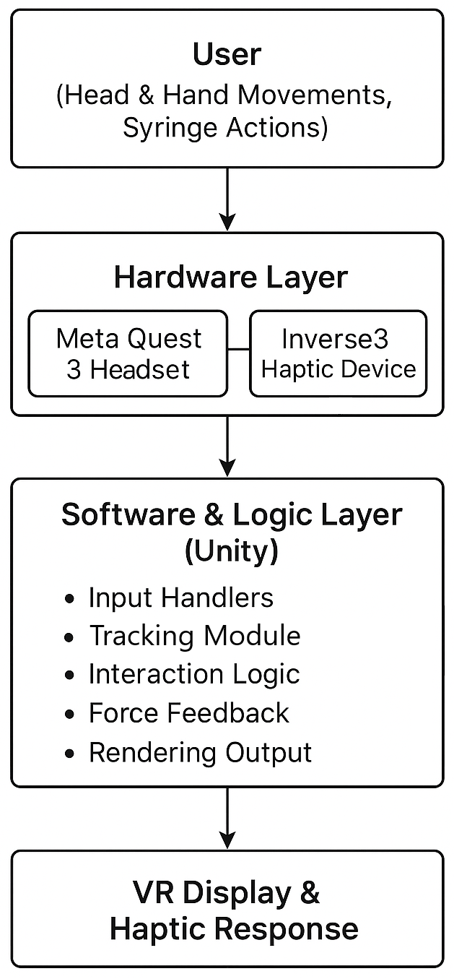
System architecture and design

Slide 6
Testing Overview
Test | Tests Conducted
Unit | Haptic force feedback 3D environment UI to detect devices out of bounds Scene audio
Integration | Synchronisation between all components
Performance | Latency <50ms. Stable frame rates. No desynchronisation Full simulation stability under real conditions
User Acceptance | Realism of Haptic force feedback Verify that 3D models are accurate Overall user experience and interaction with the simulation
Notes:
Unit and Integration Testing
Verify Unity scripts, Inverse3 SDK, and VR headset work together
Functional Testing
Check material profiles, syringe insertion, and blood draw simulation for realistic haptic feedback
Performance Testing
Ensure latency <50ms, stable frame rates, no desynchronisation
User Testing
Trials with participants to evaluate accuracy and realism of material identification

Slide 7
Final Project Limitations
Local machine:
  Running Unity must have strong computational power
  Must have a minimum of 3 USB-A and 1 USB-C ports or 2 USB-A and 2 USB-C ports
Only have 3 types of materials (skin, vein, muscle)
User cannot move Inverse 3 too quickly
Inverse 3 occasionally disconnects
Notes:
Our project has many potential risks, these include:
Calibration and realism of the haptic feedback
Unity and Inverse3 API integration difficulties
Latency/performance issues in haptic feedback
Limited device access for testing and development
Stretch goal feasibility within timeframe
System crashes or instability during demos
Unrealistic material feedback leading to poor user experience

Slide 8
Handover
Final report and demo video
Source code provided on GitHub
  Simulation designed for the Inverse3 Haptic Device and Meta Quest 3 headset
Wiki documentation provided for setup, usage, and support
Notes:
Source code hand over and code documentation
Guidelines for how to use the system/software, deploy and run the software/system
Platform or specification of the deployment/testing infrastructure environment, requirements to integrate integration with other systems/tools/accounts
Any other items that should be part of the project hand-over

Slide 9
Demo
Any questions?

